Slide 1

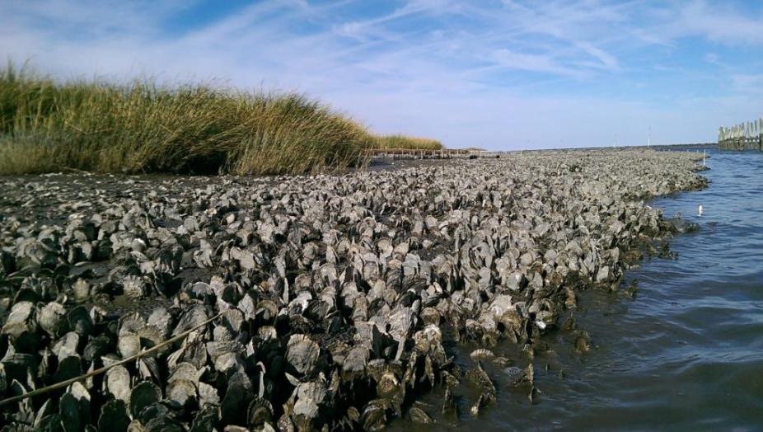

Investing in Nature to Promote Cleaner Water and Healthier Communities
Danielle Kreeger

Slide 2
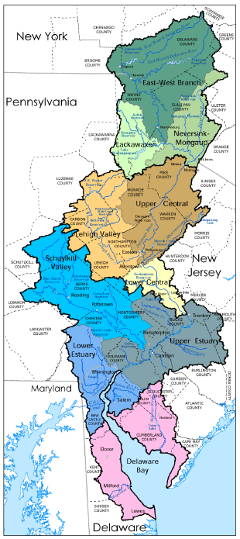
Overview
Natural Capital
Case Study: Coastal Wetlands
Types, Values, Trends
Case Study: Shellfish Beds
Types, Values, Trends
Future Solutions
Notes:
This summarizes the main chapters
Landscape indicators, WQ/WQ indicators, sediments (a new category), habitats, living resources, and climate change (building on 08).
Other new categories we wanted to develop from the workshops were system functions and restoration
Restoration is in there, and this should be treated as a starting point (like for climate in 08) – suggestions welcome
As for Functions, this will need to be deferred to next report since no one had the time or resources to really develop this section, which was intended to look at physical-chemical-biological linkages and the processes that interconnect the other categories…..

Slide 3
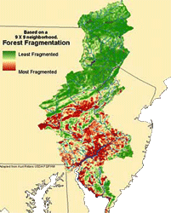
The Watershed
Notes:
This summarizes the main chapters
Landscape indicators, WQ/WQ indicators, sediments (a new category), habitats, living resources, and climate change (building on 08).
Other new categories we wanted to develop from the workshops were system functions and restoration
Restoration is in there, and this should be treated as a starting point (like for climate in 08) – suggestions welcome
As for Functions, this will need to be deferred to next report since no one had the time or resources to really develop this section, which was intended to look at physical-chemical-biological linkages and the processes that interconnect the other categories…..

Slide 4
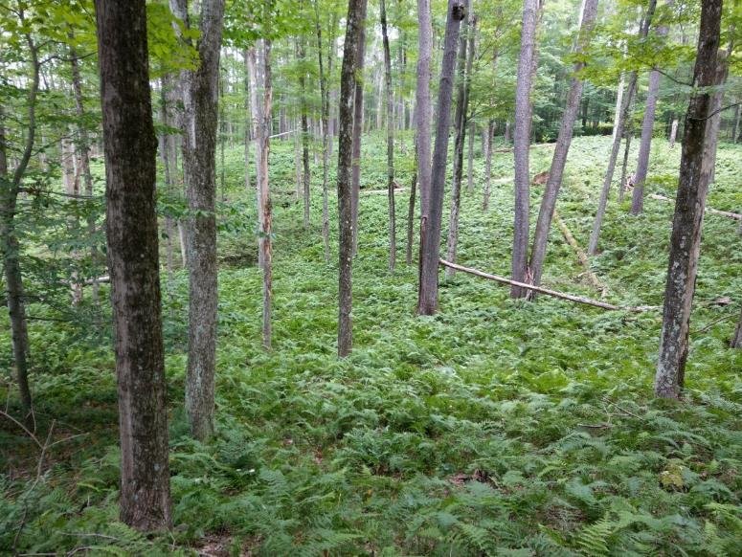
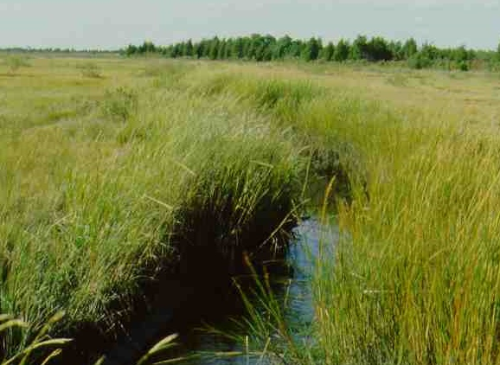
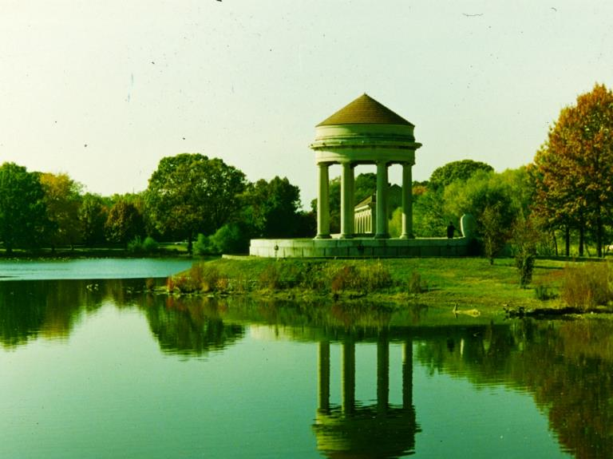
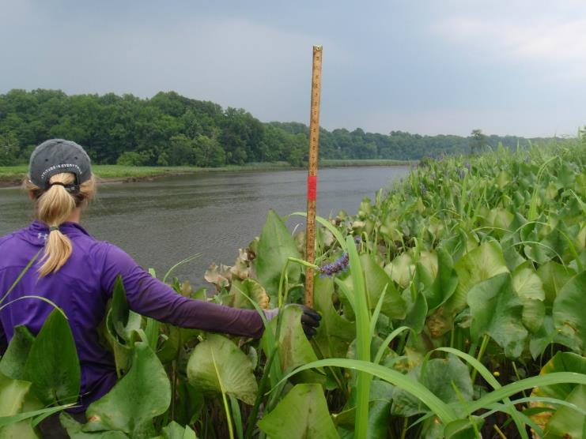

Natural Infrastructure
Notes:
Everyone can appreciate the importance of natural habitats such as forests, salt marshes, freshwater tidal wetlands, and parklands. All of these habitats provide essential benefits for people and natural ecosystems, whether they are intensely managed or barely managed at all. The new term “natural infrastructure“ is used to elevate the importance of these habitats because of their ecosystem services, and to put them on an even playing field with man-made or built infrastructure that also provides societal benefits. As human population continues to nudge up against the carrying capacity of our planet, where will we get our clean air and our clean water? It cannot come just from conserved and restored natural lands – we need to also design nature into every possible facet of the built environment to maximize nature’s benefits.

Slide 5
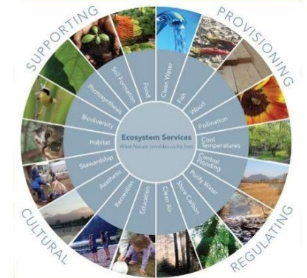


Natural Capital
https://image.slidesharecdn.com/investinginnaturalcapitalfinal-130723062011-phpapp01/95/investing-in-natural-capital-2-638.jpg?cb=1374560456

Slide 6
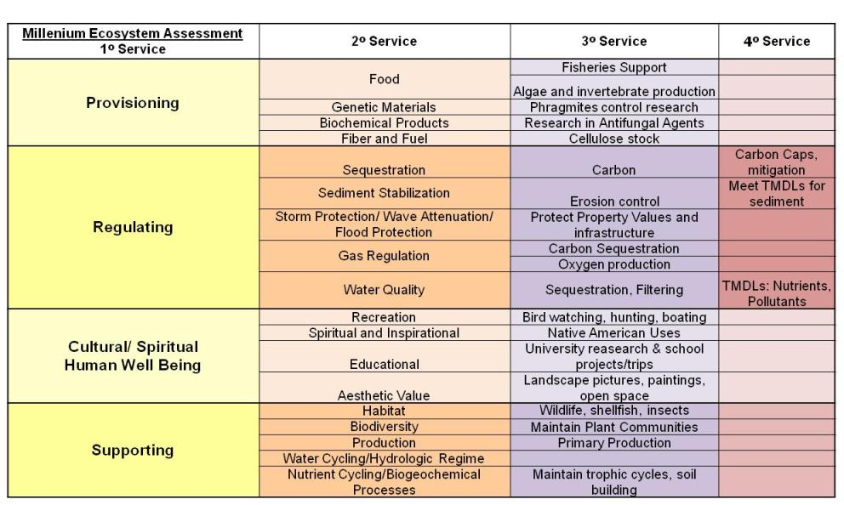
Benefits of Natural Infrastructure
…The Ecological Manhattan Project

Slide 7
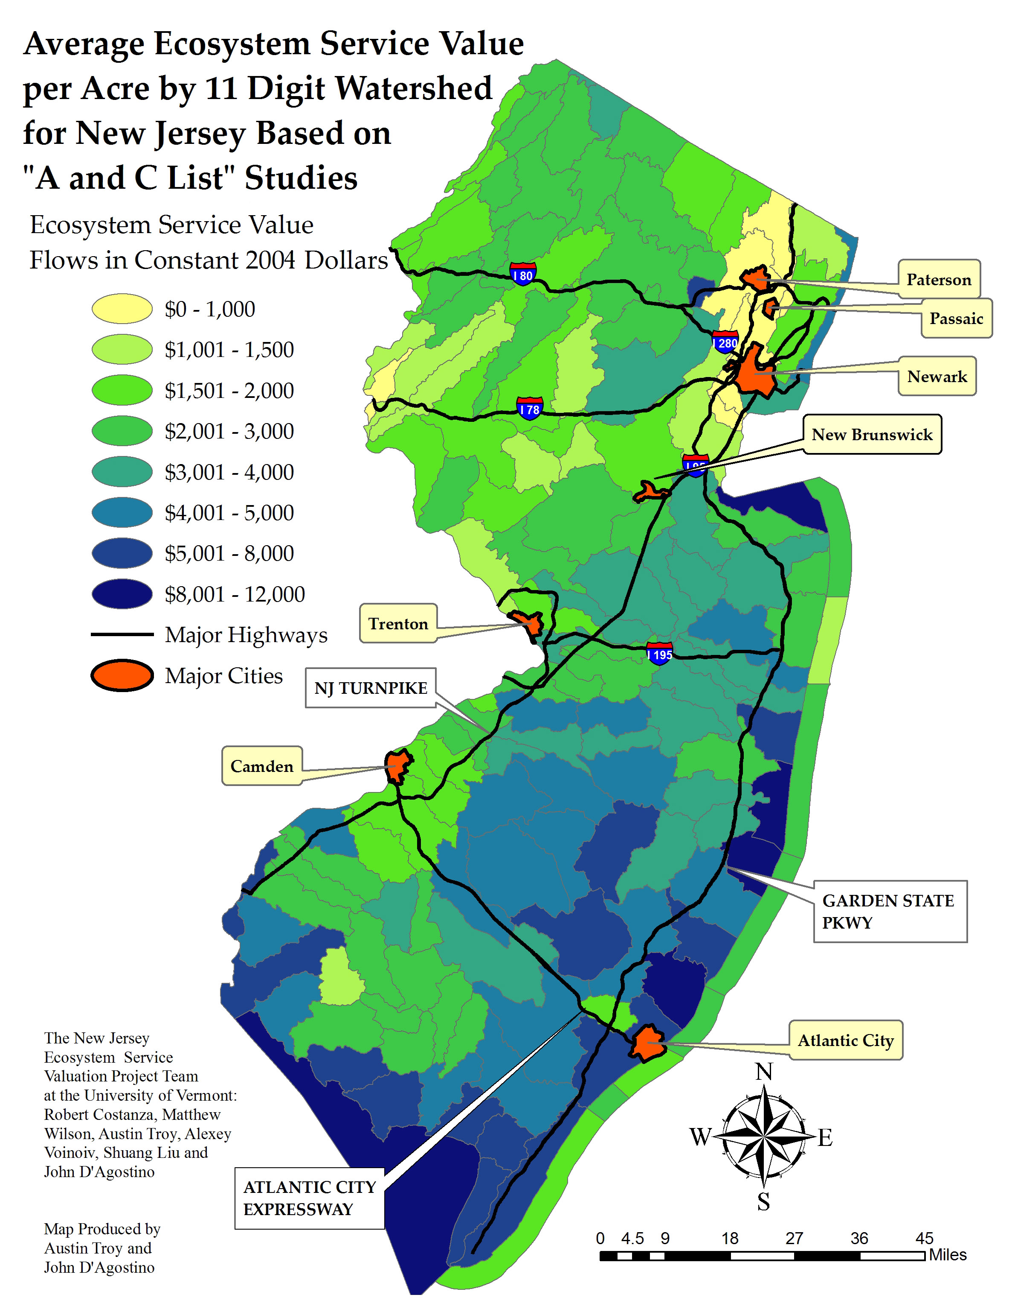
New Jersey’s Natural Capital
New Jersey Department of Environmental Protection
Kreeger
7
Slide from Bill Mates, NJDEP

Slide 8
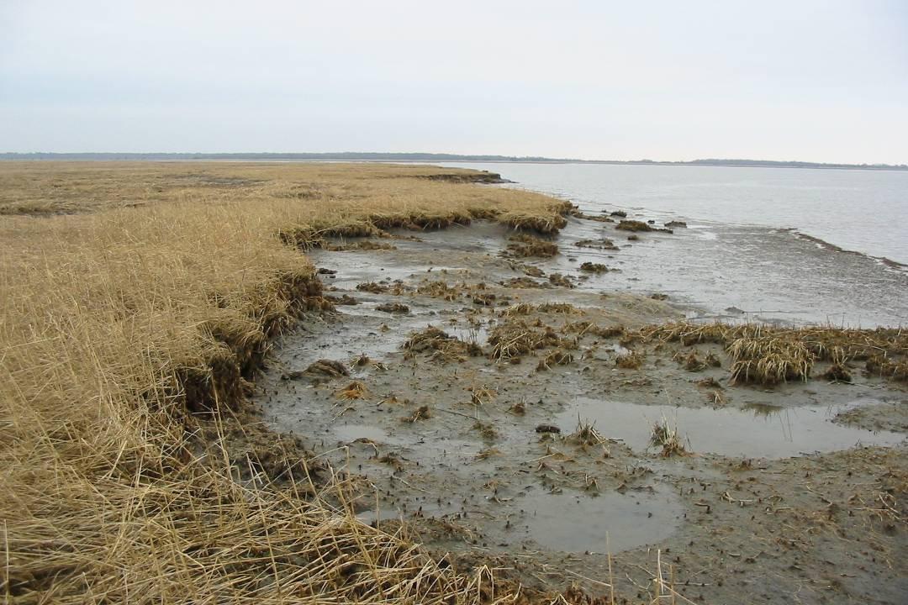
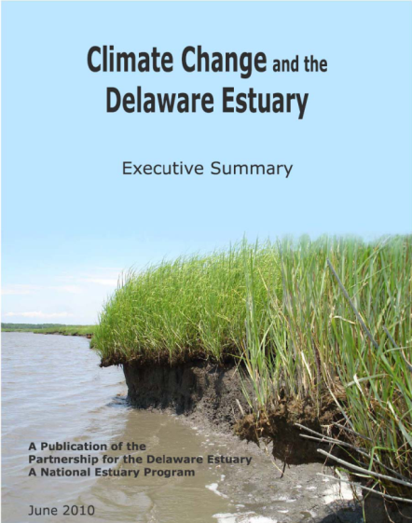
Overview
Natural Capital
Case Study: Coastal Wetlands
Types, Values, Trends
Case Study: Shellfish Beds
Types, Values, Trends
Future Solutions
Notes:
This summarizes the main chapters
Landscape indicators, WQ/WQ indicators, sediments (a new category), habitats, living resources, and climate change (building on 08).
Other new categories we wanted to develop from the workshops were system functions and restoration
Restoration is in there, and this should be treated as a starting point (like for climate in 08) – suggestions welcome
As for Functions, this will need to be deferred to next report since no one had the time or resources to really develop this section, which was intended to look at physical-chemical-biological linkages and the processes that interconnect the other categories…..

Slide 9
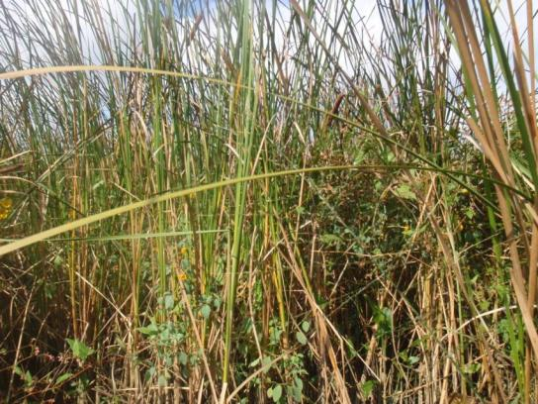
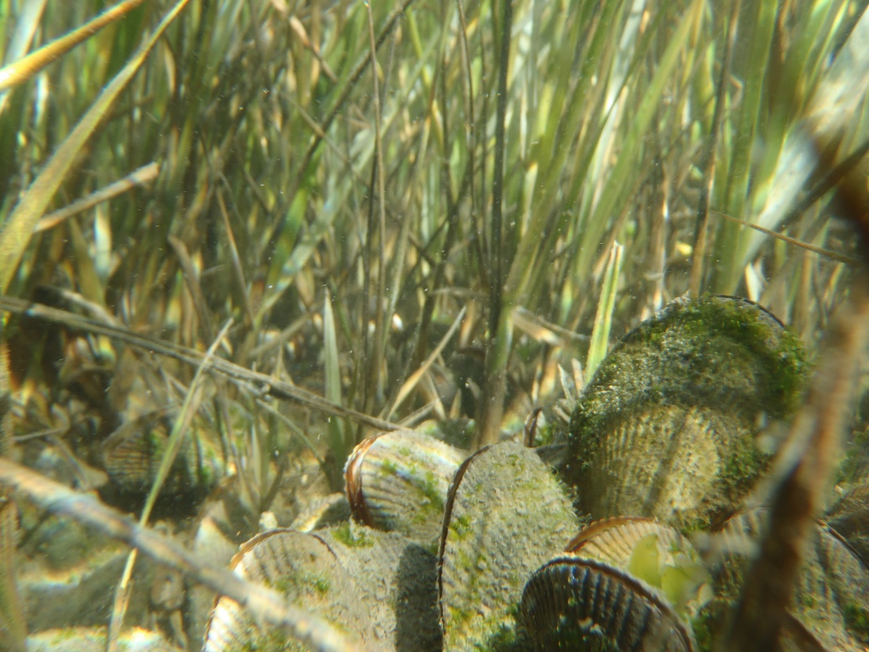
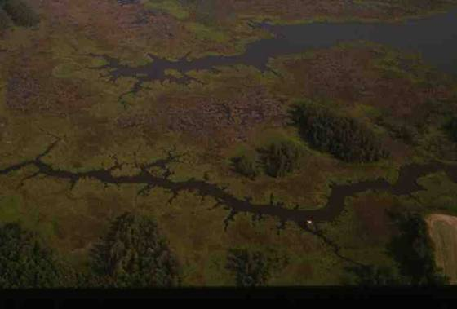
Tidal Wetlands

Slide 10
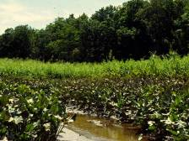
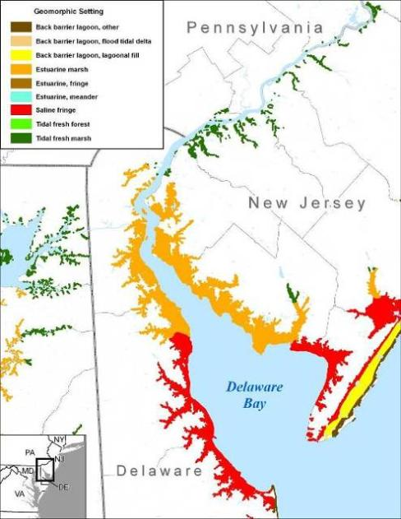


Coastal
Wetlands
Flood Protection
Water Quality
Fish and Wildlife
Natural Areas
Carbon Capture
Notes:
Here in the Delaware Estuary, for example, fortunate to have a bounty of coastal wetlands. More than 140,000 acres of tidal marshes form a near continuous fringe around the system, extending from the urban corridor to Cape Henlopen and Cape May. These are our fish factories that support the harvest and net export of blue crabs and oysters. They function like kidneys that filter many types of pollutants. They capture more carbon than any other habitat. And they are the first line of defense against sea level rise and increasingly more destructive storms. This was made abundantly clear during Hurr Sandy when damages were much more severe in areas unprotected by marshes.

Slide 11

Freshwater Tidal Marsh

Slide 12
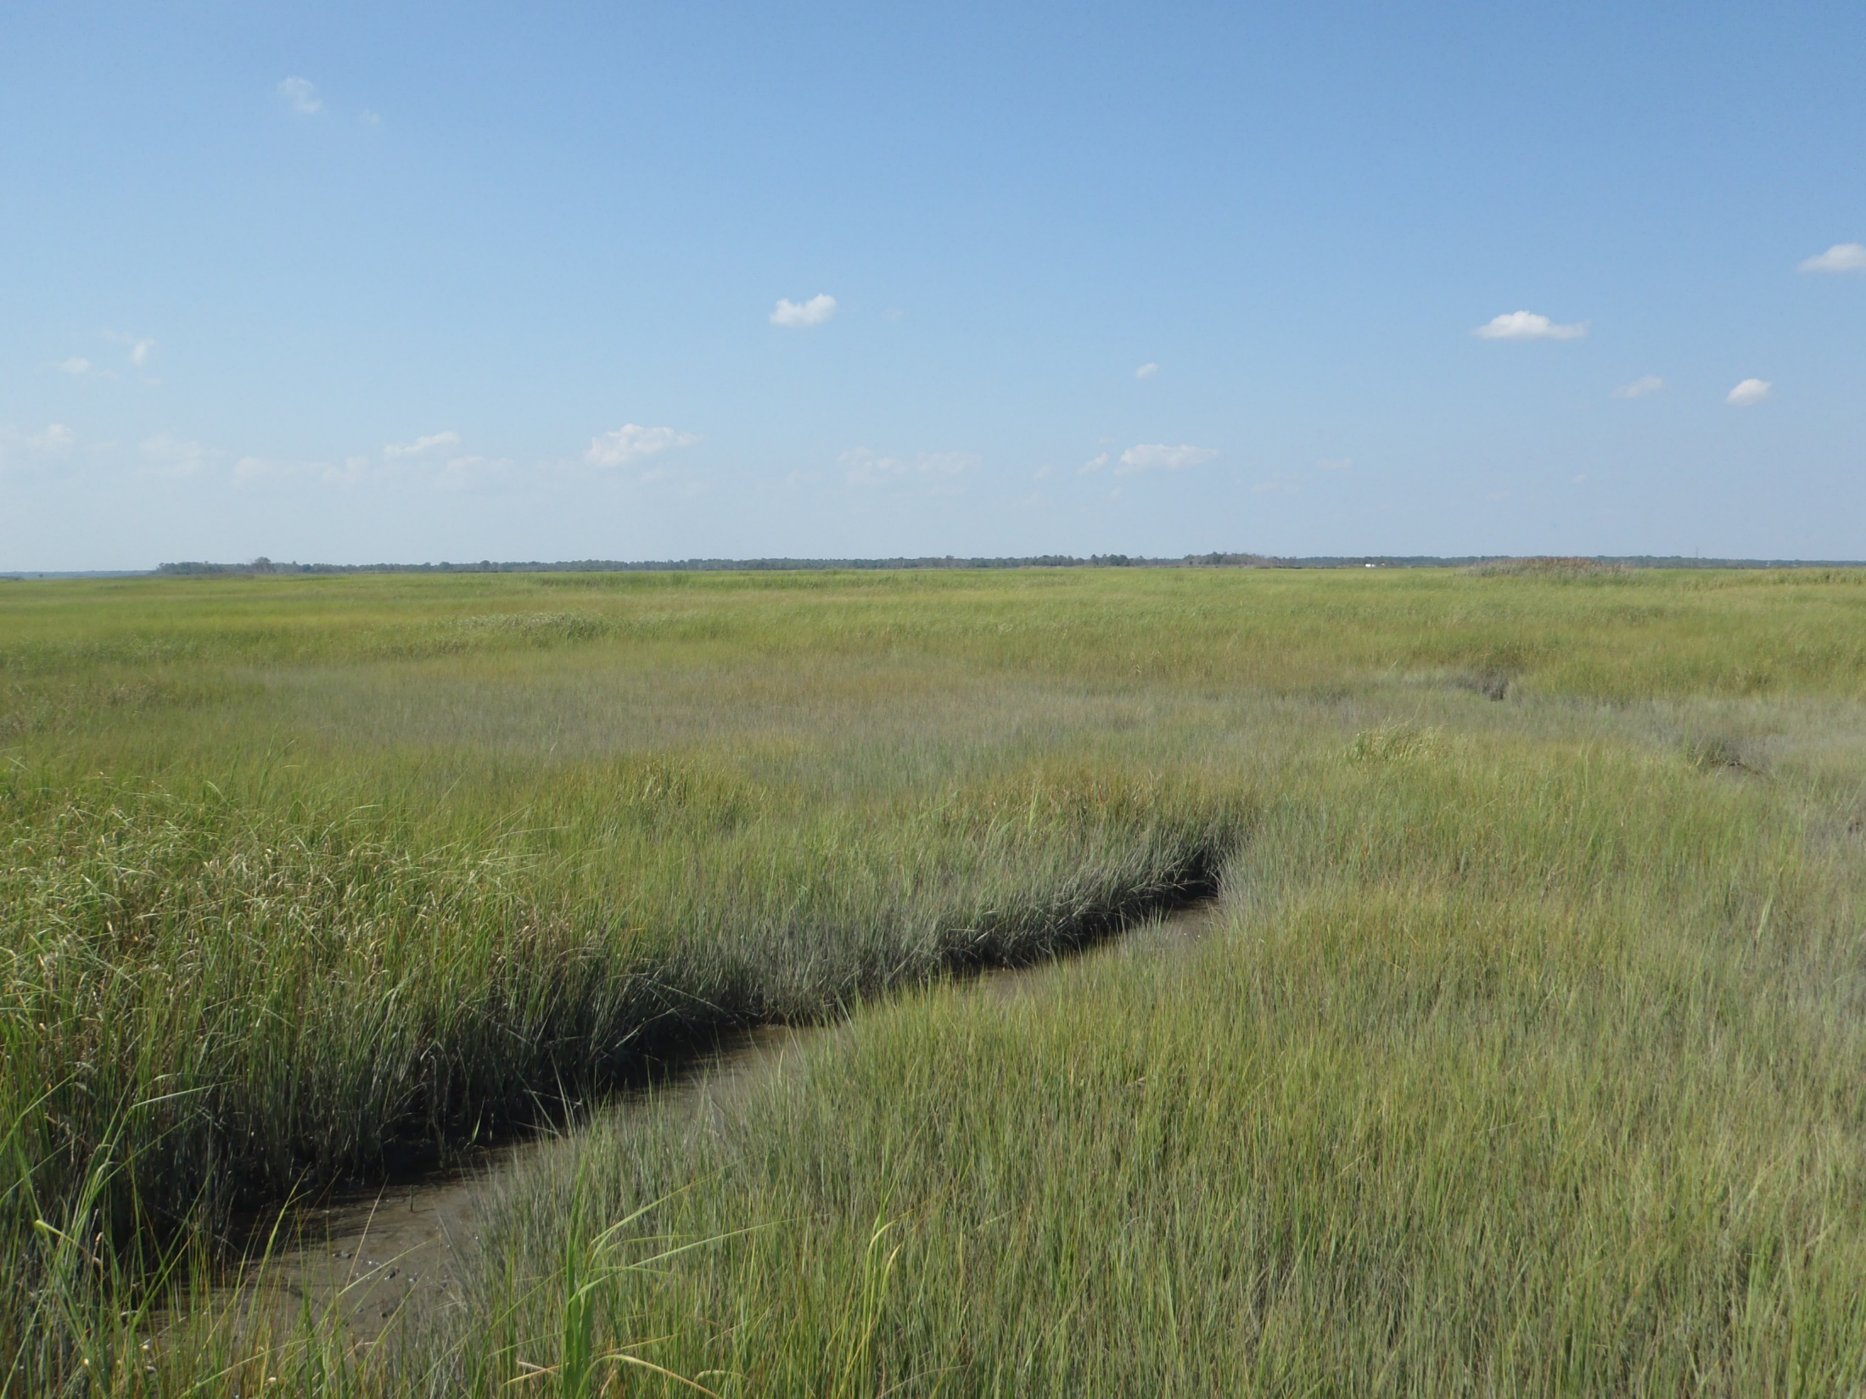
Salt Marsh

Slide 13
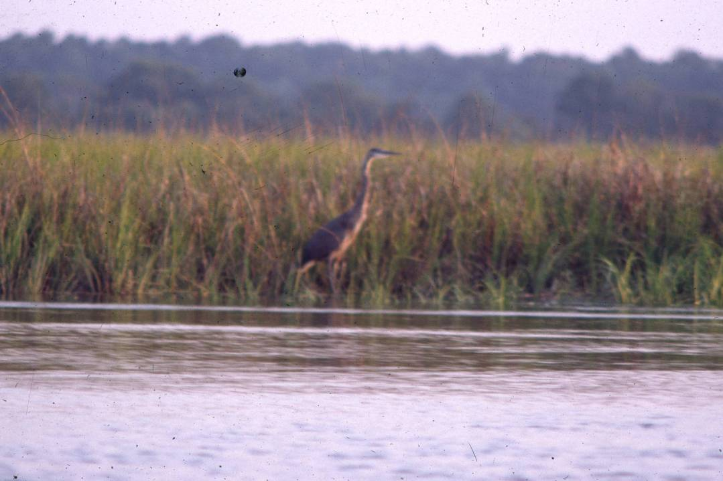
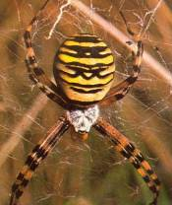
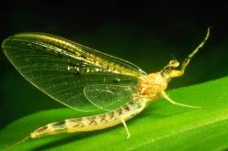
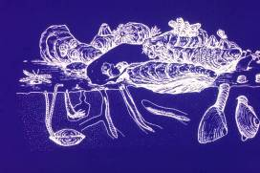
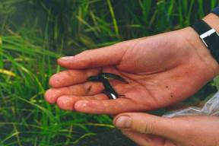
High Production
Notes:
Not just plants – also animals.
Whereas a salt marsh typically has one or two species per major niche, more in fw, not so stressed by salt

Slide 14
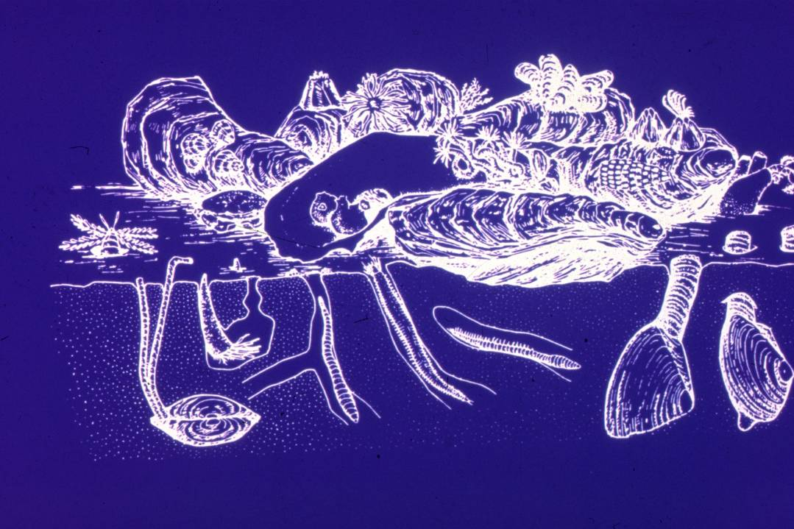

Slide 15
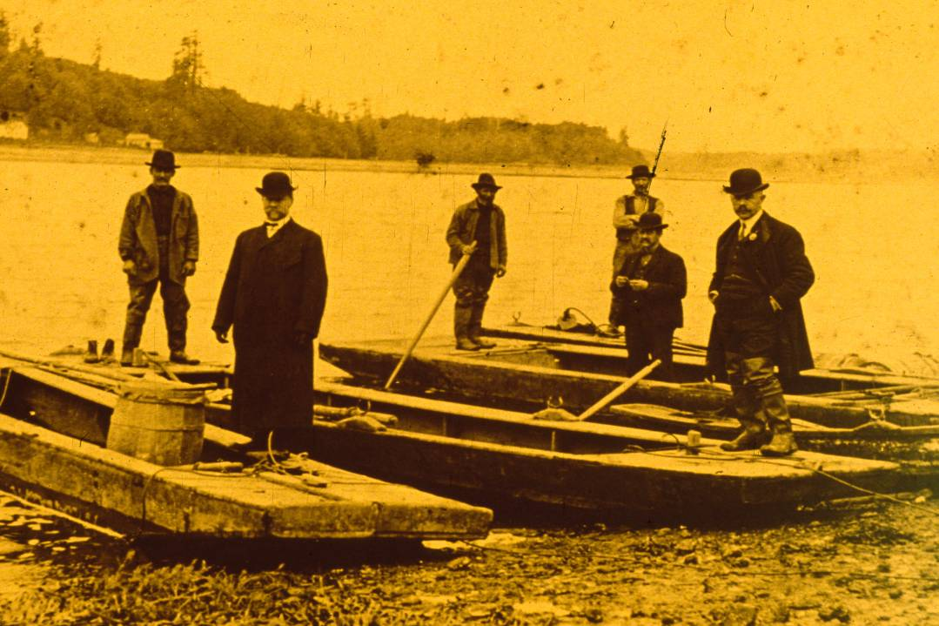
Historic Fisheries

Slide 16
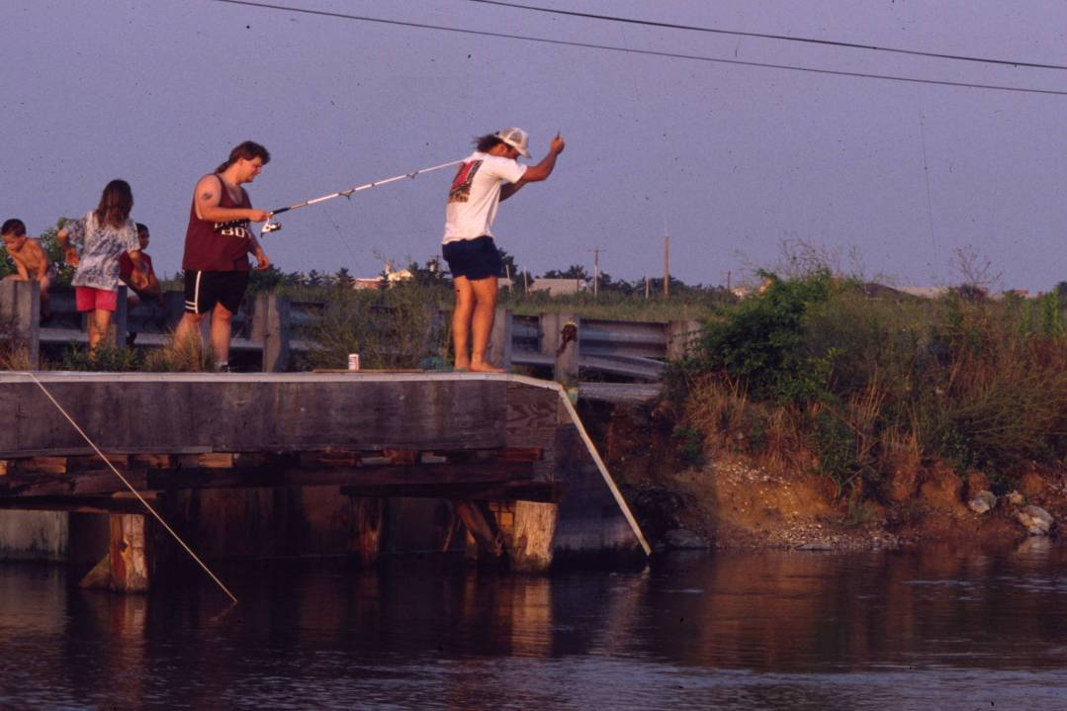
Modern Fisheries
Notes:
But fish consumption bans

Slide 17
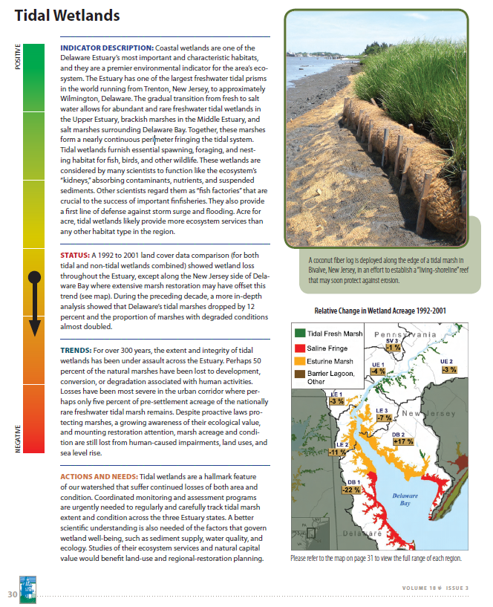
State of the Estuary Report 2008
Wetland Acreage?
no recent, consistent, high resolution data across the estuary
Condition?
no data
Notes:
Introduction to the ICEC/USNVC
17

Slide 18
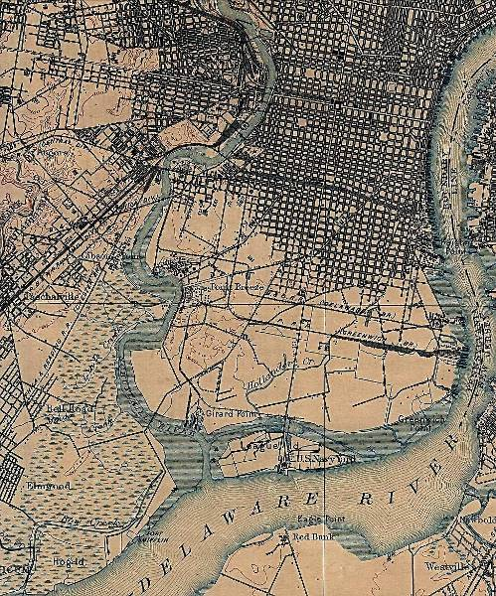
Loss of Freshwater Tidal Wetlands
Pre-Settlement ?
1973 (Patrick et al.) 2310 ha
1981 (NWI) 9347 ha
1988 (Tiner & Wilen) 1000 ha
2017 (TREB) ~802 ha
Estimated < 5% remains
1840’s Philadelphia
Notes:
Data tough to come by, but here is best estimate

Slide 19
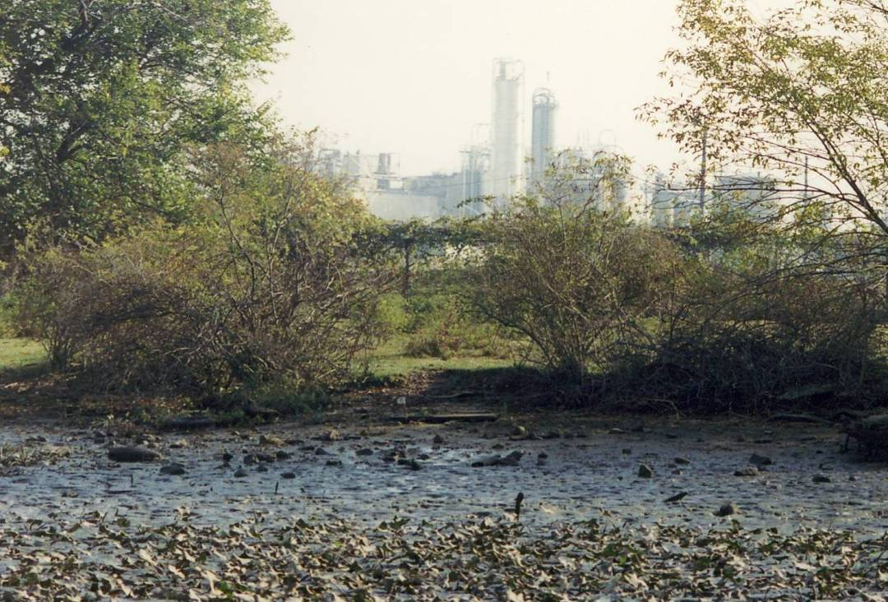
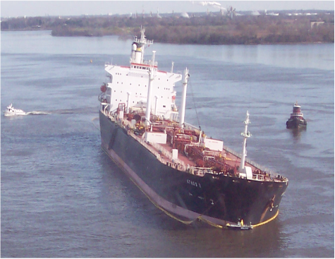

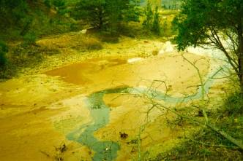
Degradation
Notes:
This is the Athos I spill on Thanksgiving weekend, 2004.
Trash in our city parks.
Leachate from contaminated sites
There is no doubt these wetlands have faced a wide diversity of insults, and
There are reports that document many species of vegetation native to our fwt marshes are now extirpated from the system

Slide 20
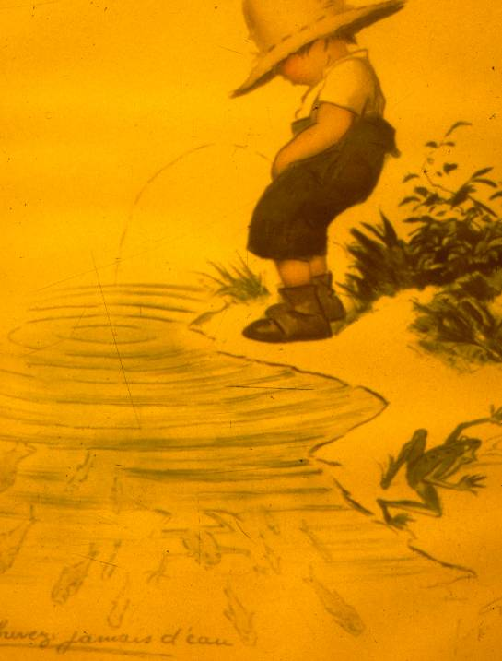
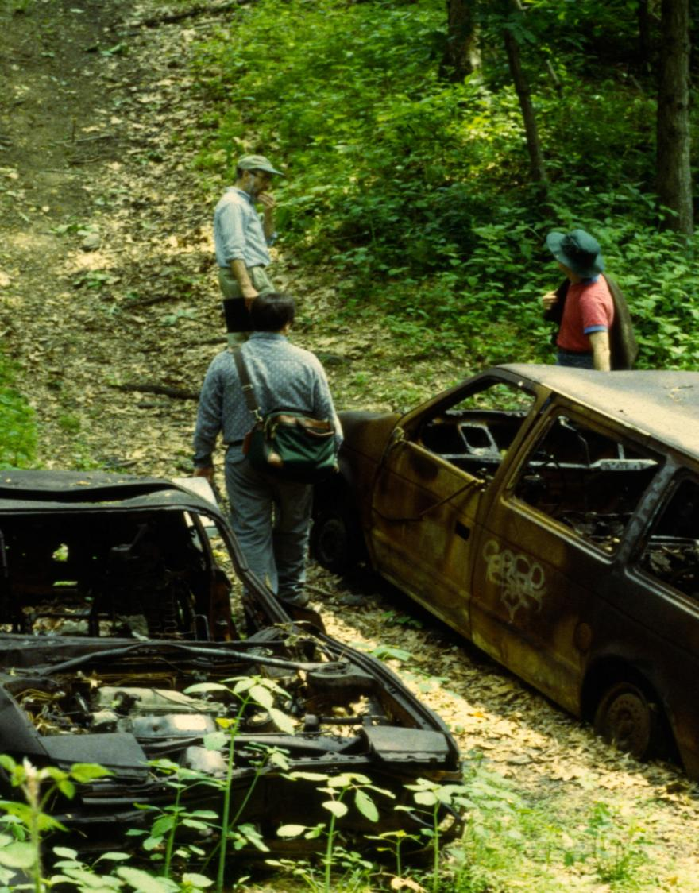
Pollution, Dumping

Slide 21
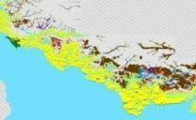
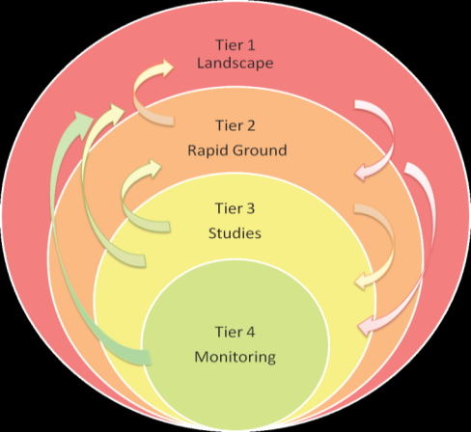
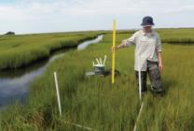
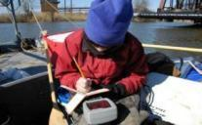
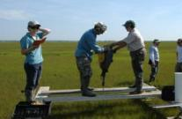
The Mid-Atlantic Coastal Wetland Assessment
Integrated monitoring of tidal wetlands
Remote
Sensing
Ground-
Truthing
Intensive
Studies
Station
Monitoring
Notes:
Monitoring gets little support traditionally, but is more critical than ever. Sandy had a silver lining for us > see value of monitoring to help guide projects

Slide 22
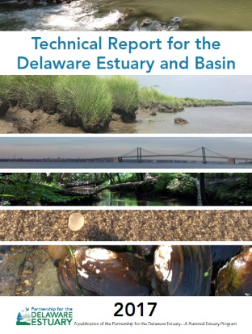

Coastal Wetland Loss
Acre per day in Delaware Estuary
http://www.delawareestuary.org/data-and-reports/state-of-the-estuary-report/

Slide 23


Two Decline Patterns
Edge Erosion (Horizontal) Interior Drowning (Vertical)
> 1 m per year edge loss
White = new open water
Source: Riter and Kearney 2009

Slide 24
Sea Level Rise and Ecological Interactions
Sediment Supply
Energy,
Erosion
Primary
Productivity
Elevation
Capitol
Sea Level
Nutrients
Slide from Don Cahoon, USGS
Courtesy of Don Cahoon, USGS
Notes:
It’s complicated – not just sediment or elevation

Slide 25
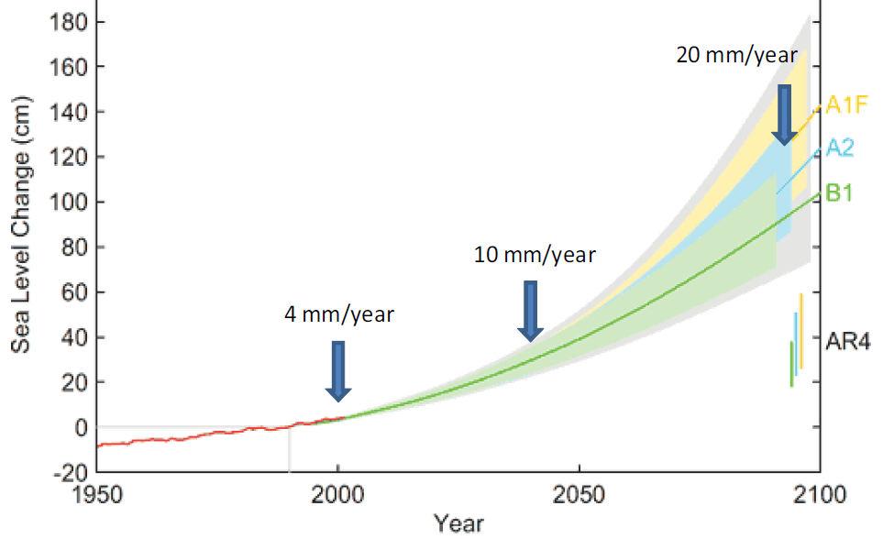
Trends
Ability of Marshes to Match SLR
  “Tipping Point”

Slide 26
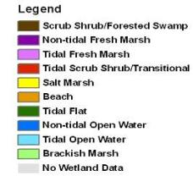
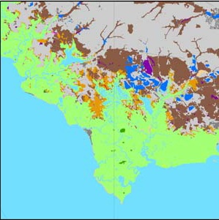
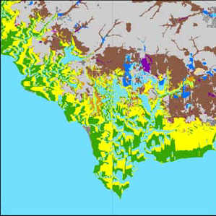
Model Predictions
Massive Habitat Conversion
Conversion of >40,000 acres Uplands to Wetlands
Conversion of >100,000 acres Wetlands to Water
Loss of Benefits >> Acreage Losses

Slide 27
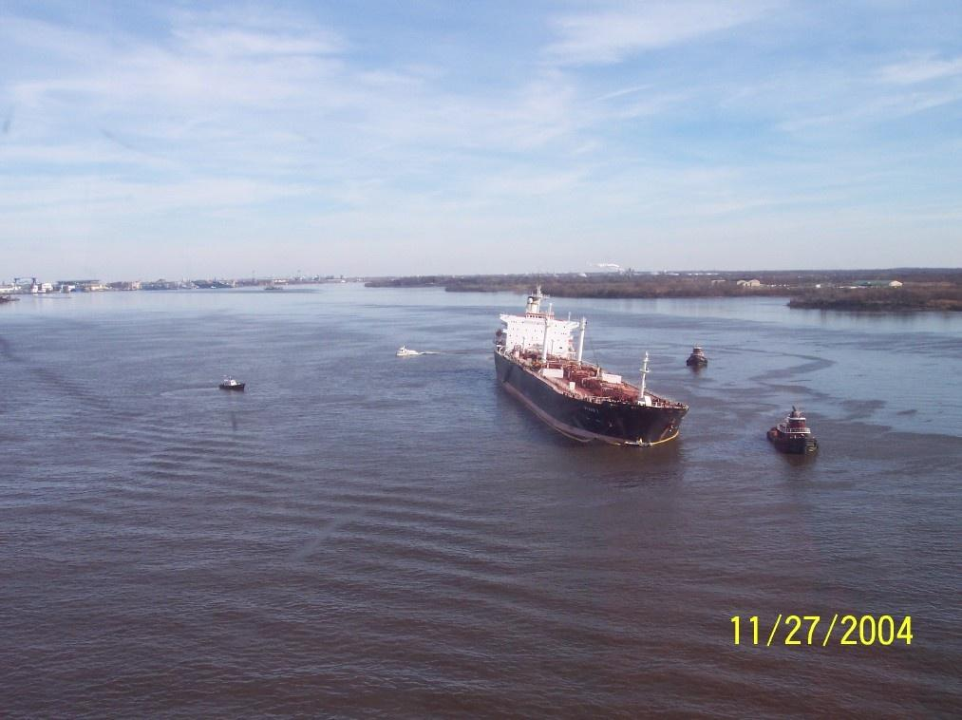
Climate Change + Other Changes
Ecological Flows
Gas Drilling
Spills
Dredging
Added Complexity
Withdrawals
Land Use Change
Development
Emerging Pollutants

Slide 28
State of the Estuary Report
Watersheds & Landscapes
    Population, Land Use, Protected Lands
Water Quantity & Hydrology
    Withdrawals, Groundwater, Consumption
Water Quality
    DO, Nitrogen, PCBs
Sediments
    Loadings, Organic Carbon, Dredging
Aquatic Habitats
    Benthic, Tidal Wetlands, Fish Passage
Living Resources
    Horseshoe Crabs, Oysters, Macroinverts
Climate Change
    Temperature, Heat Waves, Precipitation, SLR
Restoration
    Acres Restored, Types, Investment
http://www.delawareestuary.org/data-and-reports/state-of-the-estuary-report/

Slide 29
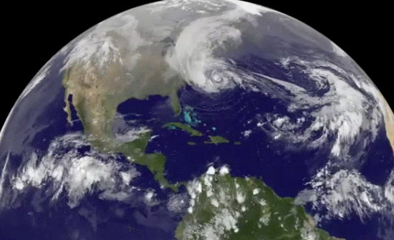
Climate Change
Temperatures
Precipitation
Sea Level
Salinity
Hurricane Sandy (NASA)
Growing
Storms

Slide 30
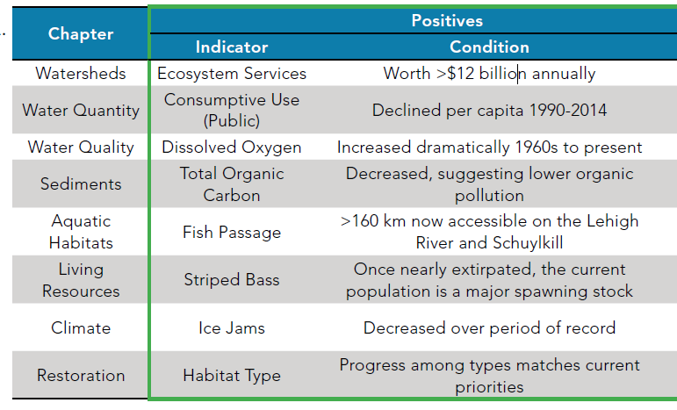
Positive Messages

Slide 31
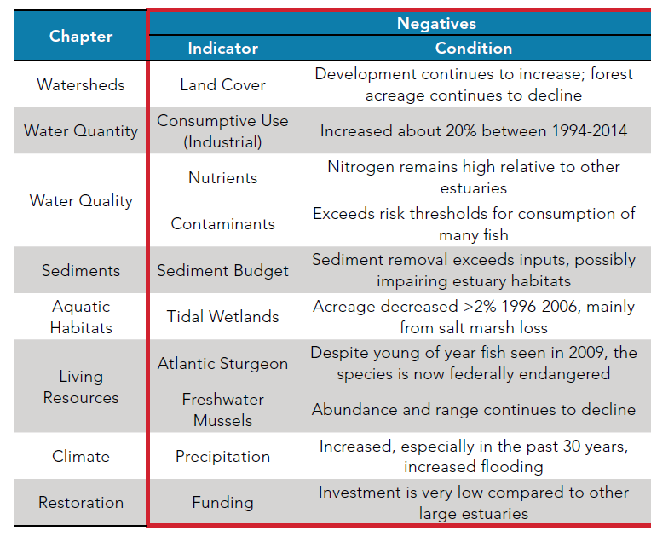
Negatives

Slide 32
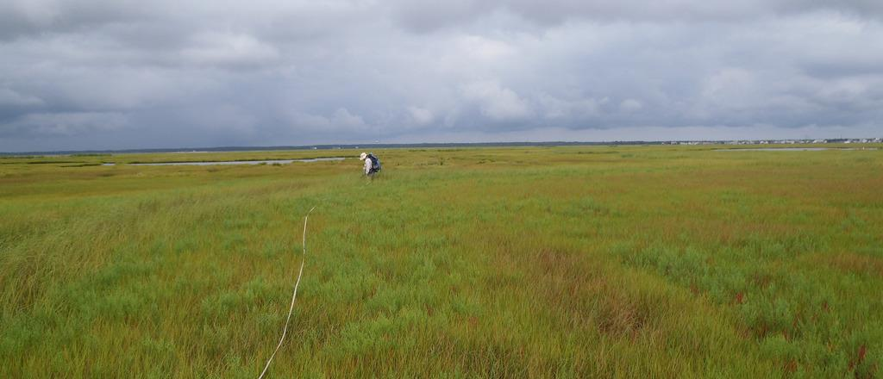
Loss of Nature’s Benefits
Greater Vulnerability to Flooding
Hurricane Sandy (NASA)
Flooding and storm damage was reduced near coastal wetlands
Notes:
Loss of natural infrastructure lowers our readiness for storms. So when the big storms come, such as Hurricane Sandy, flooding and damages are greater in coastal communities that are not protected with wetlands and reef systems.
Prior to Sandy, there was very low interest in our efforts to study and repair coastal wetlands. But after Sandy, interest has been much higher, even racing ahead of the science in some cases.

Slide 33

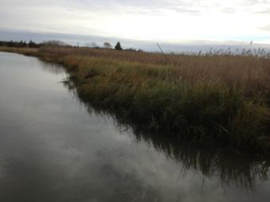
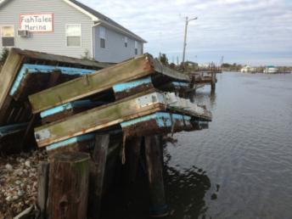
Post-Sandy Lessons
Flooding and storm damage was lower adjacent to protective coastal wetlands and dunes
PDE-Rutgers Living Shoreline undamaged
Nearby destruction with hard infrastructure
Notes:
So what did we learn from Sandy?
Not just us, but federal and state agencies and the public all reported seeing that damages were reduced in areas that were near coastal wetlands
In much the same way that dunes protect ocean and bayfront properties, wetlands afforded protection on the back bays which actually suffered more flood damages than the beachfronts.

Slide 34


Future Natural Infrastructure?

Slide 35


Natural Infrastructure and Wealth
Notes:
Found this cartoon, which to me represents the paradigm shift that is underway. McMansions on the Jersey shore have long been a sign of wealth, but without natural buffers and waters that you can swim and fish in, are you really rich? How can we include the wealth associated with natural infrastructure in our planning and management decisions?

Slide 36


Overview
The Delaware Estuary
Natural Capital
Case Study: Coastal Wetlands
Types, Values, Trends
Case Study: Shellfish Beds
Types, Values, Trends
Future Solutions
Notes:
This summarizes the main chapters
Landscape indicators, WQ/WQ indicators, sediments (a new category), habitats, living resources, and climate change (building on 08).
Other new categories we wanted to develop from the workshops were system functions and restoration
Restoration is in there, and this should be treated as a starting point (like for climate in 08) – suggestions welcome
As for Functions, this will need to be deferred to next report since no one had the time or resources to really develop this section, which was intended to look at physical-chemical-biological linkages and the processes that interconnect the other categories…..

Slide 37




Hidden Gardens
Notes:
Everyone can appreciate the importance of natural habitats such as forests, salt marshes, freshwater tidal wetlands, and parklands. All of these habitats provide essential benefits for people and natural ecosystems, whether they are intensely managed or barely managed at all. The new term “natural infrastructure“ is used to elevate the importance of these habitats because of their ecosystem services, and to put them on an even playing field with man-made or built infrastructure that also provides societal benefits. As human population continues to nudge up against the carrying capacity of our planet, where will we get our clean air and our clean water? It cannot come just from conserved and restored natural lands – we need to also design nature into every possible facet of the built environment to maximize nature’s benefits.

Slide 38





Blue Collar Bivalves
  Ecosystem Engineers
Notes:
To compare candidate restoration species, I’ve listed 5 major considerations, and here I’m focusing mostly on their ability to perform biofiltration services. They will also differ in their habitat value, etc.
First, how do different bivalve species compare with regard to their intrinsic capacity to filter particles from the water?
Second, how much can different bivalve populations actually be increased – are they at current carrying capacity and if so can we boost carrying capacity?
Third, related, are there ecological barriers for some species, such as lack of fish hosts for fw mussel reproduction, or diseases that constrain oysters?
Fourth, are there restrictions that impeded restoration, such as the NJ policy prohibiting oyster restoration in polluted waters ?
Finally, what is the level of interest in different species, often determined by whether a species is commercially valuable or “sexy”?
…In my limited time, I’ll be focusing on the first item.

Slide 39




Blue Collar Bivalves
Start
  Clean the Water
Each adult filters
> 10 gallons of water per day
No Shellfish
With Shellfish
3 Hours
Notes:
To compare candidate restoration species, I’ve listed 5 major considerations, and here I’m focusing mostly on their ability to perform biofiltration services. They will also differ in their habitat value, etc.
First, how do different bivalve species compare with regard to their intrinsic capacity to filter particles from the water?
Second, how much can different bivalve populations actually be increased – are they at current carrying capacity and if so can we boost carrying capacity?
Third, related, are there ecological barriers for some species, such as lack of fish hosts for fw mussel reproduction, or diseases that constrain oysters?
Fourth, are there restrictions that impeded restoration, such as the NJ policy prohibiting oyster restoration in polluted waters ?
Finally, what is the level of interest in different species, often determined by whether a species is commercially valuable or “sexy”?
…In my limited time, I’ll be focusing on the first item.

Slide 40












Bivalves of the Delaware
Alasmidonta
heterodon
Leptodea ochracea
Elliptio complanata
Anodonta implicata
Mya arenaria
Geukensia demissa
Mytilus edulis
Ensis directus
Mercenaria mercenaria
Crassostrea virginica
Notes:
Dozens of Bivalve Species in the DRB, ranging from headwater streams to the mouth of the ocean

Slide 41

Nature’s Benefits (Natural Capital)
Livelihoods
Lives
Health
Livelihoods
Health

Slide 42

Clearance Rates Temperatures >20ºC
9 Species: 0.5 - 1.6 L/hr/g
Notes:
read

Slide 43





Mussel Surveys
Tidal Delaware River
Population Biomass by Species
Densities up to 100 per square meter
Anodonta
implicata
Notes:
Two major species numerically dominate freshwater mussel beds in the tidal river – elco and animps
Of these the floaters can get bigger, so more biomass and hence more ecoservices

Slide 44

Physiologically-Based BioFiltration Estimates
Freshwater mussels in tidal Delaware River
Bed
TSS Filtration
Clearance Rate
Area
Tissue
Clearance
Location
2
Number
Rate
(m
)
Weight
(g)
(L hr
-1
g
-1
(gal day
-1
(kg DW
-1
-1
(gal day
)
day
-1
)
DTW
)
g DTW
)
Site 1
4,230
23,163
74,210
411,867
7.8
Site 2
18,648
477,389
992,074
5,506,008
104.2
0.875
5.55
Site 3
13,983
256,560
241,151
1,338,387
25.3
Site 4
35,525
1,662,570
586,163
3,253,202
61.6
Total
72,386
2,419,682
1,893,597
10,509,464
198.9
    =10 tons dry TSS per hectare per year
Kreeger et al. 2013
Notes:
These services are substantial – combining with other mussels, about 300,000 per hectare, filtering about 10 tons TSS per hectare per year

Slide 45



Elliptio Mussels in DRB
4.3 Billion Elliptio complanata (DK)
2.9 Million kg dry tissue weight (DK)
Clearance Rate = 1 L h⁻¹ g⁻¹ (Kreeger & Gatenby 2002)
11.2 Billion Liters per Hour
Elliptio complanata

Slide 46

Oysters in Delaware Bay
2.0 Billion Crassostrea (Powell, 2003 data)
Mean size = 0.87 g dry tissue weight (DK data)
Clearance Rate = 6.5 L h-1 g-1(Newell et al 2005)
11.2 Billion Liters per Hour
Notes:
Predictions serve as common group of “drivers” to workgroups considering vulnerabilities, impacts to future conditions.

Slide 47


Ribbed Mussels in Salt Marshes
208,000 per hectare on average
10.5 Billion Geukensia
Clearance Rate = 5.1 L h-1 g-1 (DK data)
11.7 Million Kilos Dry Tissue Weight (DK)
59.0 Billion Liters per Hour
Geukensia demissa

Slide 48

Ribbed Mussels in Salt Marshes
TSS Removal
92.6 metric tons of (dry) TSS removed per hectare per year
Particulate Nitrogen Removal
476 kg N per hectare per year
> 2,500 lbs N per acre per year
Moody Ph.D. 2017

Slide 49


How much would it cost to replace lost mussels and services with designed systems?
Current Loss Rates:
69,518 mussels per day
25,008 kg mussel DTW per year
8.4 mil L/d lost filtration capacity
Replacement Costs?
What are the options?
Designed culture systems
Marsh preservation tactics
from Tier 3 ecoservice studies
Notes:
Abstract. Ribbed mussels, Geukensia demissa, have long been regarded as functional dominant animals within many eastern USA salt marsh ecosystems. Recently, researchers have begun to explore promising new ways to harness their ecosystem services to achieve management and restoration goals, such as shoreline stabilization and erosion control (e.g., living shorelines) or water quality maintenance and remediation (e.g., removal of suspended solids and nutrients). While we continue to explore these opportunities, we must not lose sight of the continuing decline of natural stocks. For example, in the Delaware River Basin where salt marshes abound, ribbed mussel water processing is estimated at >60 billion L/hr, more than 6-fold greater than any other extant native bivalve species (including oysters). Between 1996-2006, salt marsh loss averaged 0.92 acres per day, representing a daily loss of >9 million liters of mussel-mediated water filtration capacity. Eroding marshes also release sequestered carbon and nutrients, and rates of marsh loss appear to be escalating. To offset this lost biofiltration capacity by creating new mussels in engineered systems might be more expensive than simply working to stem the loss of salt marsh habitats where the typical mussel population biomass exceeds 200 kg dw/hectare. To effectively address management goals, a multi-pronged approach is needed where strategic investments yield the greatest net ecosystem services mediated by ribbed mussels and other bivalves, especially in areas where those services are most needed.

Slide 50







Bivalve Population Declines
Future?
Freshwater Mussels: most imperiled
Oysters: prone to disease and salinity
Ribbed Mussels: losing marsh habitat
Notes:
Unfortunately…
FW Mussels are the most imperiled of all animals in North America, with shrinking species ranges and declining abundance
Oyster populations have been hit hard by non-native disease agents, and salinity rise favors those diseases
Ribbed mussels are in decline because of losing an acre per day of their favored habitat

Slide 51

Loss of Nature’s Benefits
Less Pollutant Removal
Without Shellfish
With Shellfish
Notes:
As we lose our coastal wetlands and their flanking shellfish reefs, we lose the benefits that they provide.
For example, loss of oysters and ribbed mussels means less water being filtered of pollutants. Each oyster or mussel filters >10 gallons per day, and so beds of millions function like natural water treatment plants, which operate 24/7 for free. So every acre of natural infrastructure that is lost means that we’ll need to spend more money replacing with mechanical water filtration just to sustain the same water quality.

Slide 52

The End?
The Far Side by Gary Larson

Slide 53
Overview
The Delaware Estuary
Natural Capital
Case Study: Coastal Wetlands
Types, Values, Trends
Case Study: Shellfish Beds
Types, Values, Trends
Future Solutions
Notes:
This summarizes the main chapters
Landscape indicators, WQ/WQ indicators, sediments (a new category), habitats, living resources, and climate change (building on 08).
Other new categories we wanted to develop from the workshops were system functions and restoration
Restoration is in there, and this should be treated as a starting point (like for climate in 08) – suggestions welcome
As for Functions, this will need to be deferred to next report since no one had the time or resources to really develop this section, which was intended to look at physical-chemical-biological linkages and the processes that interconnect the other categories…..

Slide 54







Shellfish Enhancement – We Have the Tech !
Mussel Propagation
Urban Living Shorelines
Shellplanting for Oysters
Fish Host Restoration
Bio-Based
Living Shorelines
Hybrid
Living Shorelines
Notes:
Predictions serve as common group of “drivers” to workgroups considering vulnerabilities, impacts to future conditions.

Slide 55

Shellfish for Cleaner Water
Headwaters to Sea
1. Non-tidal
2. Intertidal
3. Subtidal

Slide 56



Wetland Tactics
Nature-Based Solutions
Oyster/Rock Breakwaters
Living Shorelines
Sediment Placement

Slide 57

Bio-Based Living Shoreline
Goals
Stem Wetland Loss
Clean Water
Suitability
low energy
marsh edges
Location
Matts Landing, NJ
Notes:
I’m going to show two examples of our living shoreline projects.
Every project needs to be tailored to unique local site conditions. Some projects are what we call “bio-based”, meaning that the structural elements that promote resilience are mainly just plants and animals that are intrinsically resilient, such as marsh plants and shellfish that bind tightly together.
Bio-based approaches are best in lower energy areas.

Slide 58

Bio-Based Living Shoreline
April, 2010 (Before)
Notes:
This project was constructed along an eroding shoreline with a low quality marsh fringe, and the rip wrap and bulkhead are to address erosion by a marina.
In some places we start with eroding natural areas, but living shorelines can also be used to “green up” hard infrastructure.
This was just before construction in April, 2010.

Slide 59






Bio-Based Materials
Plants
Ribbed Mussels
Wooden
Stakes
Oyster Shell Bags
Coir Logs, Mats
Notes:
There are 5 main ingredients for the bio-based tactic that we chose, which were mainly all natural materials.
Mussels, plants, recycled plant fibers, wood and oyster shell
I’ll walk through the installation process next, but just to show where these things end up in a newly installed project, see the arrows.

Slide 60

May, 2010
Notes:
Initially, we place the coconut fiber logs and mats on the shore at low tide, and these are staked in and armored with shell bags lining the front logs.
This is May, just after installation, and the logs are already getting coated with mud.

Slide 61

June, 2010
Notes:
Just 1 month later, mud has filled in between and behind the logs, forming a natural terrace. This is not mud that we added, it collected naturally.
We started to put in a few plugs of plants that were salvaged from eroding areas nearby.

Slide 62

June, 2011
Notes:
Just 1 year later, you can see how the whole site has filled in with dense marsh vegetation.
The rock is still underneath. The rock was inconsequential. A duplicate LS cell was installed just upstream that did not have rock, and it performed similarly.

Slide 63


May, 2015
untreated area
Post Sandy
Bulkhead near LS
DelawareEstuary.org
Practitioners Guide
Outreach Products
Videos
Notes:
Here is the site 5 years after installation, in 2015. Note that the untreated area in the distance has continued to erode, but not the living shoreline in the forground.
Importantly, this was after Hurricane Irene in 2011 and Hurricane Sandy in 2012. The hurricanes did not do any damage to the LS. But the nearby bulkhead was damaged severely and the buildings behind it had to be torn down.
If you want to learn more about this site or this bio-based tactic, there is a lot more info on our website.

Slide 64

Bio-Based Living Shoreline
Outcomes
Less Erosion
More Shellfish & Fish
Cleaner Water
Cost
Low
Limited Maintenance
Status
Intact 7+ years
September, 2017
Notes:
To summarize, the bio-based tactic had numerous positive outcomes.
We use a scientific monitoring framework that we developed for the states of DE and NJ. This monitoring showed that erosion was stemmed, more diverse and abundant fish used the LS, and our models indicate that the project site was promoting cleaner water than the untreated shoreline.
Costs were fairly low compared to traditional hard tactics. It should be noted though that LS are like gardens that require periodic tending. For example, we replaced some front logs and materials after two severe winters where ice had scoured the edge. With this modest maintenance, the site still looks great 7 years after installation.

Slide 65


Hybrid Living Shoreline
Goals
Clean Water
Attenuate Waves
Stem Erosion
Suitability
Moderate energy
Location
Mispillion River, DE
Bio-Based Tactic
Oyster Breakwater
Notes:
The second example is what we call a hybrid living shoreline, meaning it is a mix of different tactics together.
A bio-based approach is used along the eroding marsh edge, similar to what I showed before. But waterward, a sill structure is added to dissipate wave energy and slow currents that sweep along the shoreline.
The sill for this site is mainly constructed out of oyster castles, which are concrete lego blocks that attract oysters. We also used bagged oyster shell. Over time, these surfaces get coated with oysters, and eventually the blocks are not visible, only a natural-looking oyster reef will remain.

Slide 66


June, 2014
Notes:
Construction of the breakwater was in June 2014. This was timed to occur just before oyster larvae are abundant in the water, so that we would get a quick coating of young oysters onto the castles and shell.
Construction was by hand, using wheelbarrows to move the blocks and shell across 600 feet of marsh.

Slide 67

June, 2014
Notes:
At the same time, three bio-based cells were installed along the eroding marsh edge.

Slide 68

October, 2014
Notes:
We did collect a healthy amount of juvenile oysters right after installation

Slide 69


February, 2015
Notes:
But despite the severe winter of 2015, the structures survived nicely.

Slide 70

July, 2017
Notes:
Most of the bio-based cells along the marsh edge have done terrific.
Here is a pic from a few months ago, showing how the vegetation has filled in.

Slide 71



October, 2017
October, 2017
Notes:
Oysters and mussels now colonize most of the breakwater structures. This includes the castles….

Slide 72

Hybrid Living Shoreline
Outcomes
Cleaner Water
Sediment Capture
More Shellfish
Cost
Low-Moderate
Status
Intact 3 years
Notes:
Similar to the bio-based living shoreline, this hybrid design also led to cleaner water, helped boost elevations via sediment capture, and promoted shellfish reef formation.
Costs were a bit more per linear foot than the bio-based method, but still cheaper or at least comparable to traditional tactics, which generally cannot be installed by hand.
The project continues to be in good shape after 3 years, and this trend is expected to continue as we keep getting more and more oysters every year, etc.

Slide 73







Delaware Estuary Living Shoreline Initiative
  Since 2007:
  Project Implementation
  Tactics R&D
  Scientific Monitoring
  Regional Planning
  Interstate Coordination
  Outreach, Training
Nantuxent
Money Island
Mispillion
Maurice
Lewes
Notes:
For these reasons, PDE, like many NEP partners and other programs such as being coordinated by RAE, are strongly focused on living shorelines as a new approach to stem the bleeding of these vital habitats.
We’ve been working proactively for the past 10 years to use our best scientific tools to design appropriate types of LS and install them on the ground.
It’s important to be able to show examples of LS so that marine contractors, local communities, and permitting agencies see these as a viable alternative to traditional hard armoring. So we’ve worked hard to implement projects where we can get funding and permits.
We’ve also worked with state and federal agencies to update permits rules, develop new tactics that match our local ecology, scientifically assess the projects to gauge outcomes, coordinate planning among agencies and states, and educate the public and marine contractors via workshops.

Slide 74




Freshwater Mussel Recovery Program (FMRP)

Slide 75


Restoration Via Reintroduction
>12 streams
>1000 mussels
Prioritize sites for Restoration

Slide 76





Propagation & Reseeding
Demonstration Hatchery at Fairmount Water Works
http://www.mightymussel.com/

Slide 77

Propagation
March 15, 2017
Mussel Broodstock Collection
18 degrees, blowing snow

Slide 78

Juvenile Mussels

Slide 79


Mussel Propagation & Rearing (2017)
April
Sept.
Mussels in Floating Baskets

Slide 80

Pond Rearing Trials
Sept. 9, 2017
5-Month Old Juveniles Compared to Old Adults

Slide 81


THE MUSSELS FOR CLEAN WATER INITIATIVE
OF THE DELAWARE AND SUSQUEHANNA RIVERS
WATER QUALITY ENHANCEMENT BY BEDS OF FRESHWATER MUSSELS

Slide 82








Mussel Seeding Strategy
Exhibit Hatchery
(FWWIC, 2017)
Restoration
Targets
NJ
PA
Production Hatchery
DE
Pond Grow-Out
Estimated Nitrogen Removal = $14 per Pound

Slide 83


Restoration via Habitat Enhancement
Urban Living Shorelines
Include Mussel Beds
North Camden, NJ
South Camden, NJ
Schuylkill River, PA
Delaware River, PA
Wilmington, DE

Slide 84



Alewife Floaters
Investment in Mussel Hatchery
  Produce 500,000 seed per year
  Seed are stocked into impaired streams
  Survival ~90%, lifespan ~30 years, normal growth
  Costs $400,000 per year
Notes:
So hypothetically, an investment on a mussel hatchery to propagate alewife floaters should easily produce 500,000 seed per year
When those offspring get stocked into streams and rivers, with proper conditioning, most should survive and live long and prosper
We estimate about $400K per year to operate, once built

Slide 85
Alewife Floaters
Predicted Outcomes: Nitrogen Filtration
pN
pN
Stream
seeding
starts
Stream
seeding
starts
~78,000 lbs/yr by Year 30
>870,000 total lbs by Year 30
Notes:
Nitrogen is more on people’s minds, so here are the same plots for N
The RATE of N removal would be about 78,000 pounds per year by Year 30, and the cumulative removal almost a million pounds of N removed

Slide 86
Alewife Floaters
Return on Investment ?
Healthy mussel bed ~400 pounds N per ha/yr
TSS removal would cost $400 per ton (dry weight)
Nitrogen removal would cost $14 per pound
ROI analyses ignore other ecological benefits
Notes:
Self explanatory

Slide 87











Which Species is Best?
Research – Water Quality Benefits
Which Tactic is Best?
Notes:
So this begs some important questions: which species to focus on? Which tactics are more successful at achieving management goals, such as nutrient reduction?

Slide 88


Investments in Natural Infrastructure?
Needs Paradigm Shift

Slide 89

Future Natural Infrastructure?

Slide 90

Natural Infrastructure and Wealth

Slide 91

Future Natural Infrastructure?
https://www.google.com/search?rlz=1C1ASRW_enUS677US677&biw=1920&bih=949&tbm=isch&sa=1&ei=HUkpWtnEOsOk_Qa9lrHwDg&q=crystal+ball+nature&oq=crystal+ball+nature&gs_l=psy-ab.3...319586.320652.0.320872.7.7.0.0.0.0.72.386.7.7.0....0...1c.1.64.psy-ab..0.6.338...0j0i67k1j0i8i30k1j0i24k1.0.AxSo_Lw-8bo#imgrc=6LRbrn258G4_zM:

Slide 92

Investment Varies
http://delawareestuary.org/science_programs_state_of_the_estuary_treb.asp

Slide 93




Root for the Underdog

Slide 94


CTUIR Freshwater Mussel Project
Healthy Bivalves =
Healthy Estuaries
Kreeger
Notes:
Bottom line….

Slide 95
Summary
Natural Infrastructure is increasingly valued for ecosystem services
Expanded investment in natural infrastructure is needed to sustain and enrich lives and livelihoods
Monetizing natural capital is coming, carrying both risks and rewards (Ecological Manhattan Project)
New and promising nature-based tactics are being developed, but a paradigm shift and better support is needed to achieve broader implementation
Investments in natural capital will yield highest ROI if guided by science and managed adaptively
Notes:
As others have discussed, living shorelines are far superior to traditional hard armoring tactics in supporting healthy ecological conditions.
They can also be cheaper and possibly keep pace with sea level rise, whereas hard structures cannot.
NEPs have been playing vital roles on the front lines of living shoreline development, implementation and translation.

Slide 96

Thank You!
Danielle Kreeger, Ph.D.
Science Director
(302) 655-990, x104 │ DelawareEstuary.org
Connecting people, science, and nature
for a healthy Delaware River and Bay

Slide 97

Questions?
    For More Info
    http://delawareestuary.org

